Slide 1
Cs-452 Project Presentation
Ministry of Environment
Group-1
Burak, Cemal, Cüneyt, Mehmet, Mert, Rıdvan

Slide 2
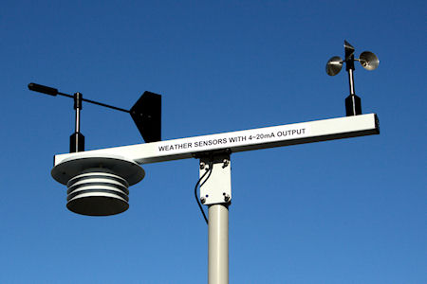
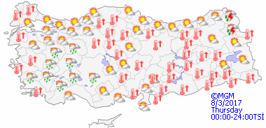
Business Drivers
Better weather forecasting is aimed
System proposal by the Ministry of Environment
Installation of the prototype to test the business need
Possible collaborations with private companies
Budget constraint

Slide 3
Business Need & Value
1.Business Need
Provide the Ministry of Environment with the data acquired from the sensor network
2.Business Value
2.1 Increase customer satisfaction
2.2 Credibility of the Ministry
2.3 Possible financial income

Slide 4
Feasibility Analysis
1. Technical Feasibility
1.1 Adaptation from other projects developed
1.2 A linear completion of the project
1.3 High possibility of project acceptance, constant user involvement
2. Economic Feasibility
2.1 Providing the weather forecasts to the private companies for revenue
2.2 Non-profit organization, public service

Slide 5
3. Organizational Feasibility
3.1 The ministry's credibility will increase
3.2 Project champion is Ministry
3.3 The fact that the Ministry is a non-private organization

Slide 6
Non-functional Requirements
1. Operational Requirements
1.1 System should integrate with the current weather forecasting system.
1.2.A healthy network connection should be provided.
1.3.Ensure that a continuous electrical connection is provided for the system.
2. Performance Requirements
2.1 The system must be available 24 hours daily
2.2.The system must be able to utilize alternative sources of electrical power to ensure continuous electrical connection.
2.3.Response time should be as low as possible in order to get accurate forecast.
3. Security Requirement
3.1.Ensure that the system is safe against physical effects.
3.2.The security of the network must be ensured so that the network connection is not sabotaged.
4. Cultural and political Requirements
4.1 The system must be installed in accordance with the regulations of the Ministry of Environment.
4.2 The national resource rate of system must be at least 50%.

Slide 7
Identification of key performance measure
1.Size and Scale
2. Location
3. Communication an Internet Accessibility
4. Energy
5. Data Management And Collection
6. Sustainability

Slide 8
Database Selection and Design
MVC type pattern
data (from sensor etc)
accurate logic
user friendly interface

Slide 9
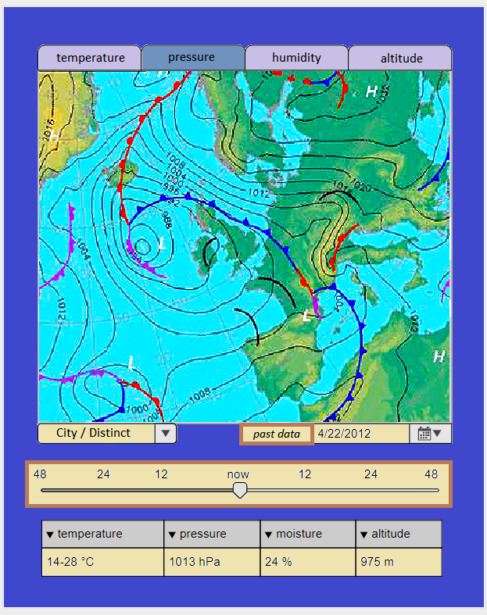
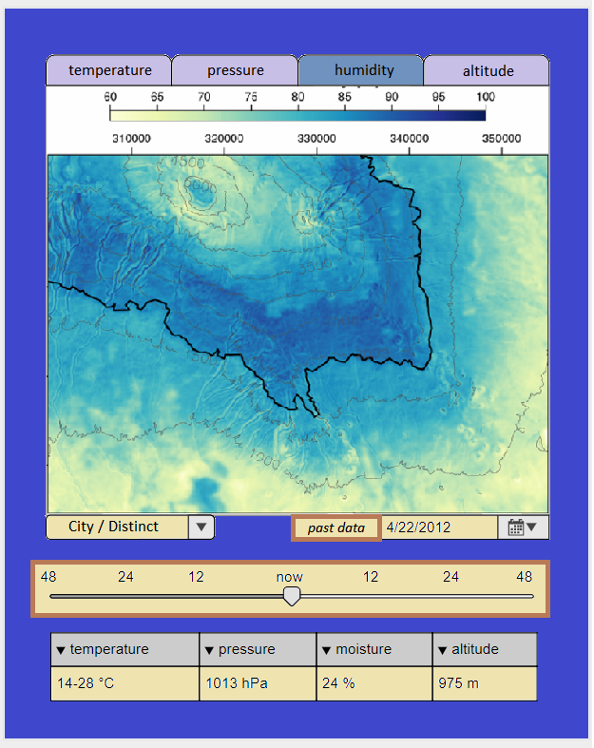
UI Design

Slide 10
Security Design
Security sensitivity
Network Security
Low cost, low power hardware
Alternative security protocols (MiniSec)
Hardware Security
Jamming/Tampering
Environmental conditions

Slide 11
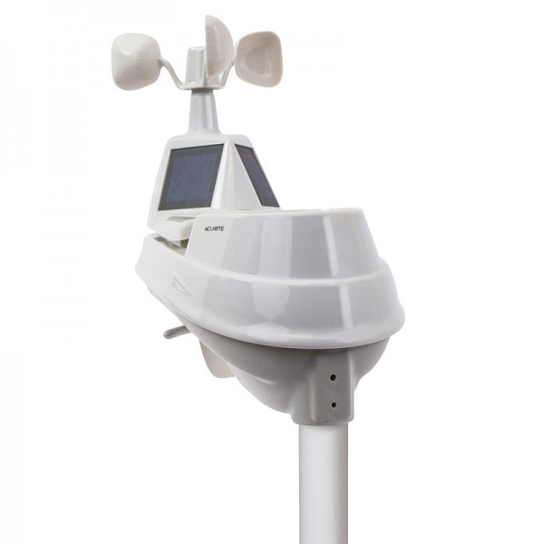
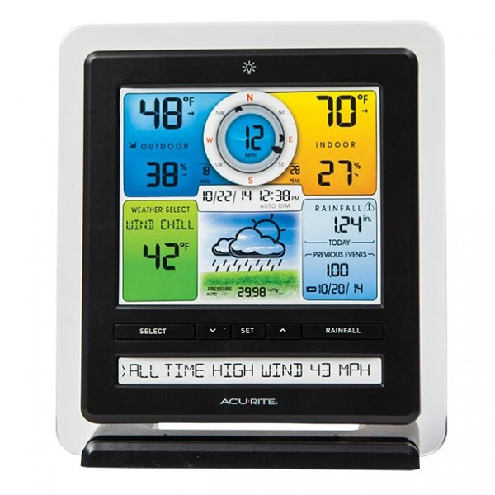
Hardware Selection/ System Construction Plan
Wind Speed | 0 to 159 kph
Wind Speed Accuracy | +/-1 kph below 10 kph +/- 2 kph from 10 to 50 kph +/- 3 kph from 50 to 100 kph +/- 5 kph from 100 to 159 kph
Temperature Range | -40 to 70 degrees Celsius
Temperature Accuracy | +/- 1 degrees Celsius
Humidity Range | 1% to 99% Relative Humidity
Wireless Range | 1000 meters
Rainfall Capacity | 0.25 mm and up
Rain Gauge Accuracy | +/- 0.05mm per centimeter of rainfall
Data Reporting | Every minute
Solar Power | Solar Panel minimum 10 Watt,and run time is 15 days without direct sunlight, needed is 2 hours daily of direct sunlight to maintain battery charge.

Slide 12
Installation and Operation Plan
Test Design
Conversion : Parallel Conversion, Pilot Conversion, Whole-System Conversion
Change Management : Resistance to change, Benefits of to-be system
Training : What to train, How to train
Post-implementation Activities : System support, System Maintenance, Project Assessments (Team review, system review)
Unit Testing : Black-box (CRC cards, class diagrams, contacts)
Integration Testing : Interaction Testing (class, sequence, communication diag.)
System Testing : Performance Testing, Security Testing
Acceptance Testing : Alpha Testing, Beta Testing

Slide 13
THANKS FOR LISTENING :)

